Slide 1

STOCKHOLM

Slide 2
Sponsorer
Microsoft
XLENT Integration & Services
AXIANS

Slide 3
Agenda
16:00 – Start
16:10 – What is Azure IoT
16:30 – What is Node.js
17:00 – Start with labs
19:00 Pizza & Beer

Slide 4
We are here to help
Mikael Håkansson – XLENT Integration & Services
Abdul Haseeb – Microsoft
Noemi Lindqvist – XLENT Integration & Services
Emil Hamalao – XLENT Integration & Services
… and YOU!

Slide 5

Bootcamp Content
http://bit.ly/azureiotbootcamp
#AzureIoT

Slide 6
Setup of this bootcamp
Laptop
Raspberry PI 3 Model B
Texas Instrument TI Sensor Tag
Temperature
Accelerometer
Gyroscope
Magnetometer
Humidity (relative humidity and temperature)
Barometer (pressure and temperature)
Optical light intensity (LUX)
Create a local Bootcamp folder e.g. ”C:\IOTBOOTCAMP”

Slide 7
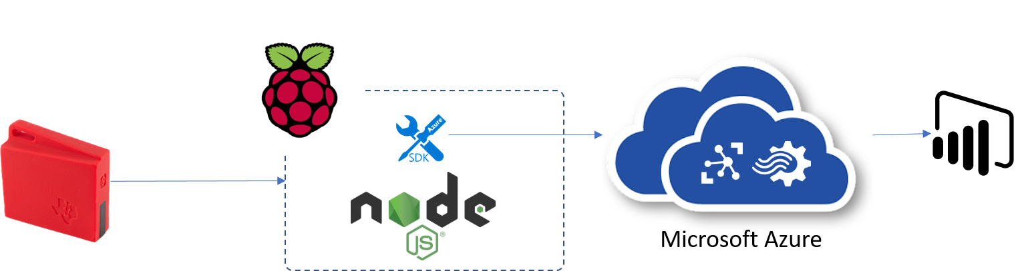
LABS
#1 - Submitting telemetry data to the cloud

Slide 8
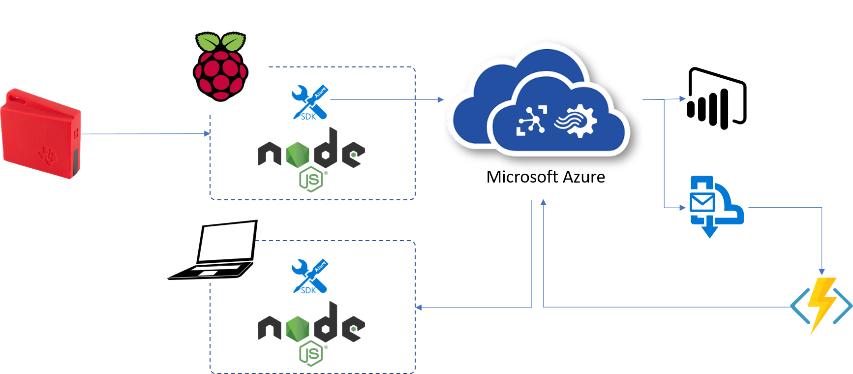
LABS
#2 - Receiving notifications from IoT Hub

Slide 9

LABS
#3 - Manage your device with device twins

Slide 10
You should have installed…
… Node.js
… Visual Studio Code
… Putty
… Azure Account
… Power BI Account

Slide 11
Introduction to Azure Portal and Azure IoT Hub

Slide 12
Introduction to Node.js & JavaScript

Slide 13


Why is JavaScript?
IoT Developers are not easy to find
Node.js / JavaScript is the fastest growing developer platform today

Slide 14

What is Node.js?
Node.js® is a JavaScript runtime built on Chrome's V8 JavaScript engine.
Node.js uses an single threaded, event-driven, non-blocking I/O model that makes it lightweight and efficient.
Node.js is platform independent.

Slide 15
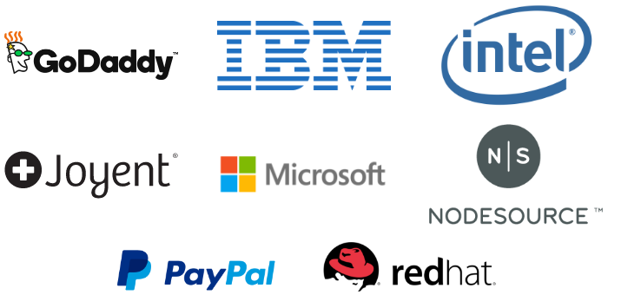
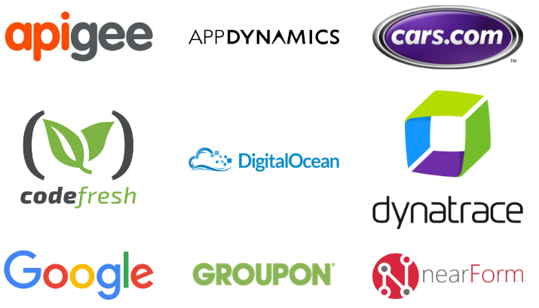
What is Node.js?
The project
The Node.js project is supported by the Node.js Foundation
Sourced at Github
Managed under an open governance model

Slide 16
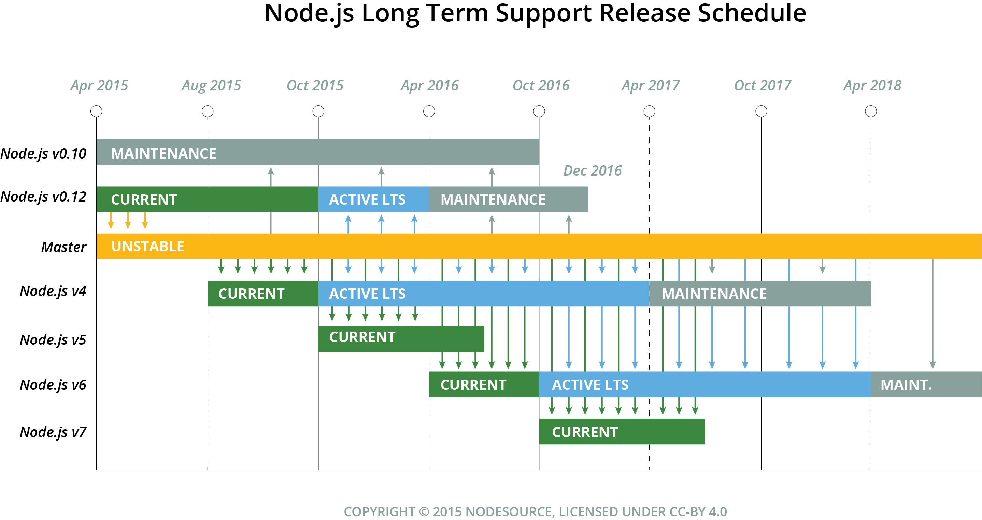
What is Node.js?
Versioning
CURRENT - Released from active development branches of this repository
LTS - Releases that receive Long-term Support (18 + 12 months)
LTS Status | Release | LTS Start | Maintenance Start | LTS End
Maintenance | v0.10 | - | 2015-10-01 | 2016-10-31
Maintenance | v0.12 | - | 2016-04-01 | 2016-12-31
Active | v4 | 2015-10-01 | 2017-04-01 | 2018-04-01
N/A | v5 | N/A
Pending | v6 | 2016-10-18 | 2018-04-18 | 2019-04-18

Slide 17
What is Node.js?
APPLICATION
NODE.JS
BINDINGS
(NODE API)
LIBUV
(ASYNCHRONOUS I/O)
JAVASCRIPT
EVENT QUEUE
WORKER THREADS
BLOCKING OPERATION
V8
(JAVASCRIPT ENGINE)
FILE
NETWORK
OS OPERATIONS
EVENT LOOP
PROCESS
EXECUTE CALLBACK

Slide 18
What is JavaScript?
A high-level, dynamic, untyped, and interpreted programming language. It has been standardized in the ECMAScript language specification
Notes:
High-level … förlåtande
Förklara att javascript är ett JIT kompilerat språk
var a = 2;
console.log(a);
3();

Slide 19
JavaScript Syntax
Values and Types
Operators
Variables and Blocks
Conditional statemets
Loops
Functions
Notes:
Use chrome console…
a = b * 2;
”;” not necessary in the same way punctuations are not mandatory for us to understand a text
Show alert();
Make note of the fact that alert is a browser function not a javascript function. Same goes for prompt(). Use console.log…

Slide 20
JavaScript – Values and Types
Primitive values
Boolean
Number
String
Null
Undefined
Objects
Date
Structured data
Collections
Functions
Notes:
var a = 12.12345;
var b = a.toFixed(2) / 1;

Slide 21
JavaScript – Values and Types
Dates
new Date();
new Date(value);
new Date(dateString);
new Date(year, month, day, hour, minutes, seconds, milliseconds);
If no arguments are provided, the constructor creates a JavaScript Date object for the current date and time according to system settings (UTC).
Date.now()
returns the numeric value corresponding to the current time - the number of milliseconds elapsed since 1 January 1970 00:00:00 UTC.

Slide 22
JavaScript – Values and Types
Structured data: JSON
var user = {
id: 1,
firstName: 'Jim',
lastName: 'Morrison'
};ions:
var numbers = [1, 2, 3, 4];

Slide 23
JavaScript - Operators
EQUAL
a = 1;
a = a + 2;
a += 2;
EQUALITY
a == b (loose-equals)
a === b (strict-equals)
a != b (loose-not-equals)
a !== b (strict-not-equals)
”falsy” values:
0
-0
””
false
null
undefined
if(error){
// handle error
}

Slide 24

JavaScript – Values and Types
var a = 12;
a++;
a = a + ' hours';
Notes:
var a = 12.12345;
var b = a.toFixed(2) / 1;

Slide 25
JavaScript - Variables and Blocks
var a = 42; //(Function scope)
let b = 16; //(Block scope)
const AGE = 7;

Slide 26
JavaScript - Variables and Blocks
Block
var b = 4;
{
var t = 2;
console.log(b);
}
console.log(t);
var b = 4;
{
let t = 2;
console.log(b);
}
console.log(t);

Slide 27
JavaScript - Variables and Blocks
function add (x,y) {
return x+y;
}
for (var a = 5; a < 10; a++) {
console.log(a);
}

Slide 28
JavaScript - Loops
for
for (a = 5; a < 10; a++) {
// ...
}
while
while(condition){
// ...
}
foreach
numbers.forEach(function (n) {
console.log(n);
});

Slide 29
JavaScript - Functions
function add(x, y) {
return x + y;
}
var subtract = function (x, y) {
return x - y;
}

Slide 30
JavaScript - Functions
function foo(x) {
return ++x;
}
function bar(y) {
return ++y;
}
var z = foo(bar(40));

Slide 31
Time for callbacks….
Accept this…

Slide 32
function foo() { function bar() { // Do someting } bar(); };

Slide 33
function foo( var = function() { // Do someting }
) {
bar
bar(); };

Slide 34
function foo(
bar
) {
bar(); };
var do = function() { // Do someting }
foo(do);
!== foo(do(1));

Slide 35
let’s take a deep breath…
…anonymous callbacks

Slide 36
function foo(
bar
) {
bar(); };
foo(function() { // Do someting });
var do = function() { // Do someting }
foo(do);

Slide 37
Samples
client.sendEvent(message, function (error) {
if (error) {
console.log("Unable to send message. Error:" + error);
}
else {
console.log("Successfully submitted readings to the IoT hub");
}
});

Slide 38
Samples
setInterval(function () {
// Do something
}, 2000);

Slide 39

Node Package Manager (NPM)
npm is the default package manager for the JavaScript runtime environment Node.js and allows users to consume and distribute JavaScript modules that are available on the registry.

Slide 40
JavaScript – modules
function Contact(first, last, phone) {
this.firstName = first;
this.lastName = last;
this.phoneNumber = phone;
this.name = function () {
return this.firstName + " " + this.lastName;
};
}
var theDude = new Contact("Jeff", "Bridges", "123456789");
console.log(theDude.name());

Slide 41
Let’s start…
Notes:
'use strict'
const VAT = 0.2;
const PRODUCTS = [
{id:1, name:"Fazer Kexchoklad", price:12.4},
{id:2, name:"Snickers", price:8.2},
{id:3, name:"Dajm", price:19.0}
]
var accountBalance = 10;
function buy(product, callback){
var tax = calculateVAT(product.price);
try{
withdraw(product.price);
console.log("You bought a "+ product.name +" for " + product.price+ " SEK");
console.log("VAT: " + tax.toFixed(2) + " SEK");
callback();
}
catch(err){
callback(err);
}
}
function calculateVAT(amount){
return amount * VAT;
}
function withdraw(amount){
if(amount > accountBalance){
throw "Insufficient funds."
}
accountBalance -= amount;
}
buy(PRODUCTS[2],function(err){
if(err){
console.log(err);
}
else{
console.log("You balance is " + accountBalance.toFixed(2) + " SEK");
}
});
// Expected output:
// You bought a Snickers for 8.2 SEK
// VAT: 1.64 SEK
// You balance is 91.8 SEK

